Slide 1
Online Machine Learning application to Marketing
VeryBuy Dataset
工管輔數學三 孫利東

Slide 2
About Me
Past has past, only present is true
Education: National Taiwan University
Major: Business Administration
Minor: Mathematics
Additional Courses Field: Computer Science, Finance, Industry Engineering
Interested Research Field: Game Theory, Optimization, Statistical Learning
Ongoing Project (2021.1~2021.6)
University MINS Group Cofounder: NTU ScoreSharing & NTHU ScoreSharing provider
Enterprise Risk Monitor System, cooperate with Ernst & Young
Option Pricing python open library (American, European, Lookback, Rainbow…)

Slide 3
Content
Mathematics proof will be skipped. Feel free to discuss with me if interested with the proof
Quick Management Overview
Data Description
Large Data Problem
Relationship between “buy” and “add to cart”
Dynamic RFM & Online Grouping
Business Case Example: Arrival Forecasting and Customized Marketing
Further Improvement (Gradient descent to strengthen combination problem)

Slide 4
Quick Management Overview
Customer’s dynamic and Heterogeneity are both consider in this project
No relationship between customer buying, clicking, add to cart, and view -> Increasing view may not lead to more buying
Dynamic Customer Grouping can solve streaming data problem, for example, Customer Log Data
Customer Arrival can be fitted by Generalized Gamma Distribution
Methodology propose in this presentation can be used in customized marketing, recommendation system, and e.t.c

Slide 5
Data Description & Goal
Large dataset cause RAM to shut down, algorithm & data structure need to be used
Data Description
Size: 31.5 GB
Column Numbers: 25
Time: 2021/2/1 - 2021/2/28
Goal
Relationship between buying, add to cart, and viewing
Customer survival prediction
Customized Marketing

Slide 6
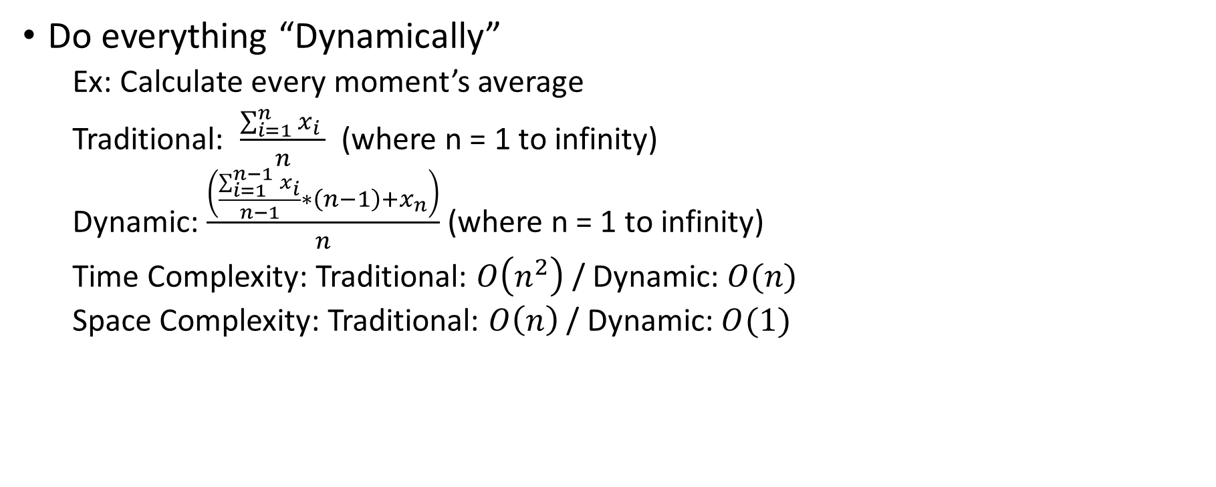
Large Data Problem (Computation Problem)
Dynamic method can help reduce space complexity and time complexity
Do everything “Dynamically”
Ex: Calculate every moment’s average
Traditional: $\frac{\sum_{i=1}^{n}{x_{i}} }{n}$ (where n = 1 to infinity)
Dynamic: $\frac{\left(\frac{\sum_{i=1}^{n−1}{x_{i}}}{n−1}∗\left(n−1\right)+x_{n}\right)}{n}$ (where n = 1 to infinity)
Time Complexity: Traditional: $O\left(n^{2}\right)$ / Dynamic: $O(n)$
Space Complexity: Traditional: $O\left(n\right)$ / Dynamic: $O(1)$

Slide 7
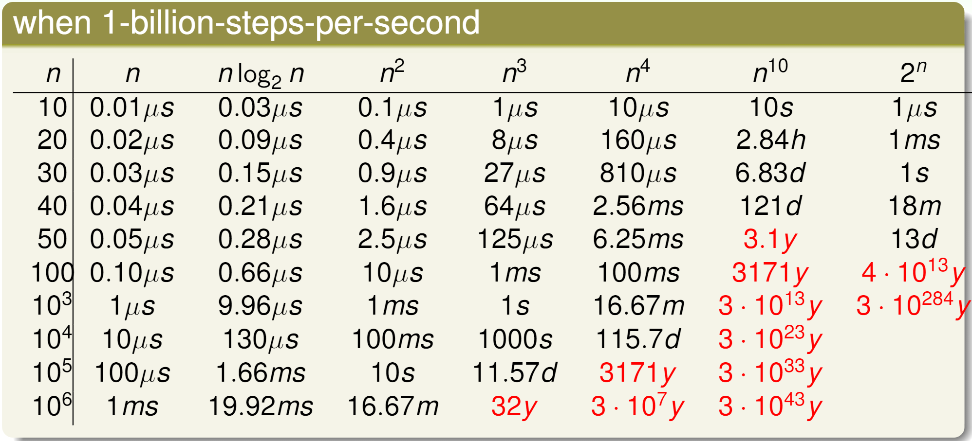


Why Complexity Important
Adapt from NTU DSA, 林軒田, 2021 spring

Slide 8
Large Data Problem (Size Reduction)
After sampling and filtering, the data size reduce from 31.5 to 5.19GB
Sampling:
Problem: Chi-square-test (test sampling distribution is similar to real distribution) is ineffective in multi-column.
Alternative: Use Chi-square-test column by column. (Assume no relationship between columns)
Filtering:
Situation: Most customers only “window shopping”
Solution: Filter out all the customers didn’t buy things in this month

Slide 9
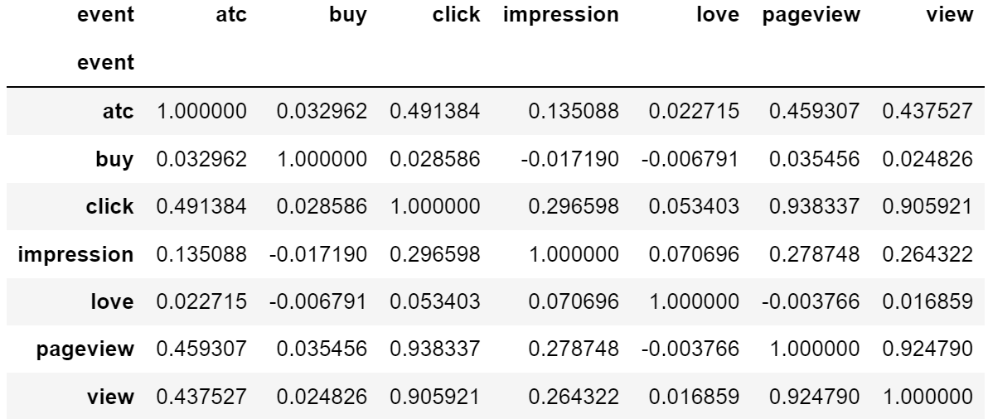



Relationship between “buy” and “add to cart”
Little “linear” relationship between “buy”, “add to cart”, and “view”
-> Increasing view may not lead to more buying
Correlation Matrix
(Assume Linear Relationship)

Slide 10
Dynamic RFM
Sacrifices recency, but earn every moment customer FM
Traditional (different result in different period):
R: Recency
F: Frequency ( 1 / 3.2)
M: Monetary (Average)
Dynamic (dynamically fit the real-time period):
R: Recency
F: Frequency -> T: Term (3.2 / 1)
M: Monetary (Exponential Smoothing -> give highest weight to latest data)

Slide 11
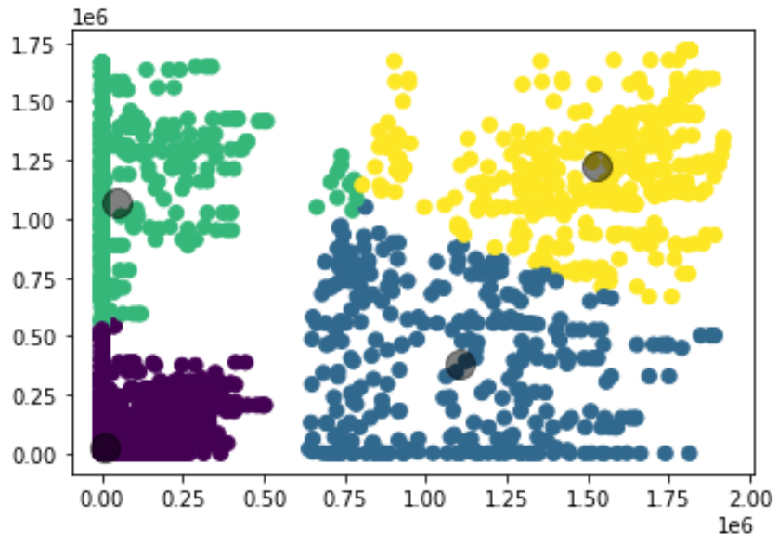
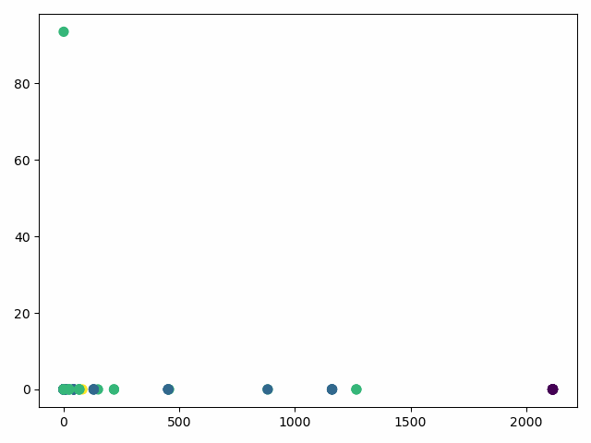
Online(Dynamic) Grouping
Online method considers how time change in grouping, but traditional way doesn’t
Traditional Kmeans method
Online(Incremental) Kmeans method
Add to cart term
Add to cart term
Buy term
Buy term

Slide 12
Why Online K-Means
Online Learning can both model customer Heterogeneity & Dynamic
Strength
Able to change the model as time goes by, i.e. better to modeling streaming data
Little time and space complexity need to update new data
Provably be better or equal to K-Means in probability
Weakness
More computation time at the beginning
More complex mathematics to prove that Online Machine Learning works
Bad performance in small size of data

Slide 13
Business Application
Out-of-date problem: Since fashion changes quickly, so using the same model in different period is weird. Online learning update our model every period, make it fit to the world all times.
Customer behavior change: Online model could find out how each customer change their behavior over time
Explanation: Online model can help us see how we grouping step by step, easy to explain to your supervisor

Slide 14
Business Application
Out-of-date problem: Since fashion changes quickly, so using the same model in different period is weird. Online learning update our model every period, make it fit to the world all times.
Customer behavior change: Online model could find out how each customer change their behavior over time
Explanation: Online model can help us see how we grouping step by step, easy to explain to your supervisor

Slide 15
Online machine learning Application
Arrival Forecasting and Customized Marketing

Slide 16
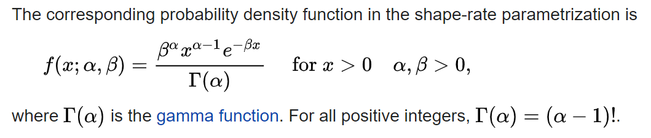
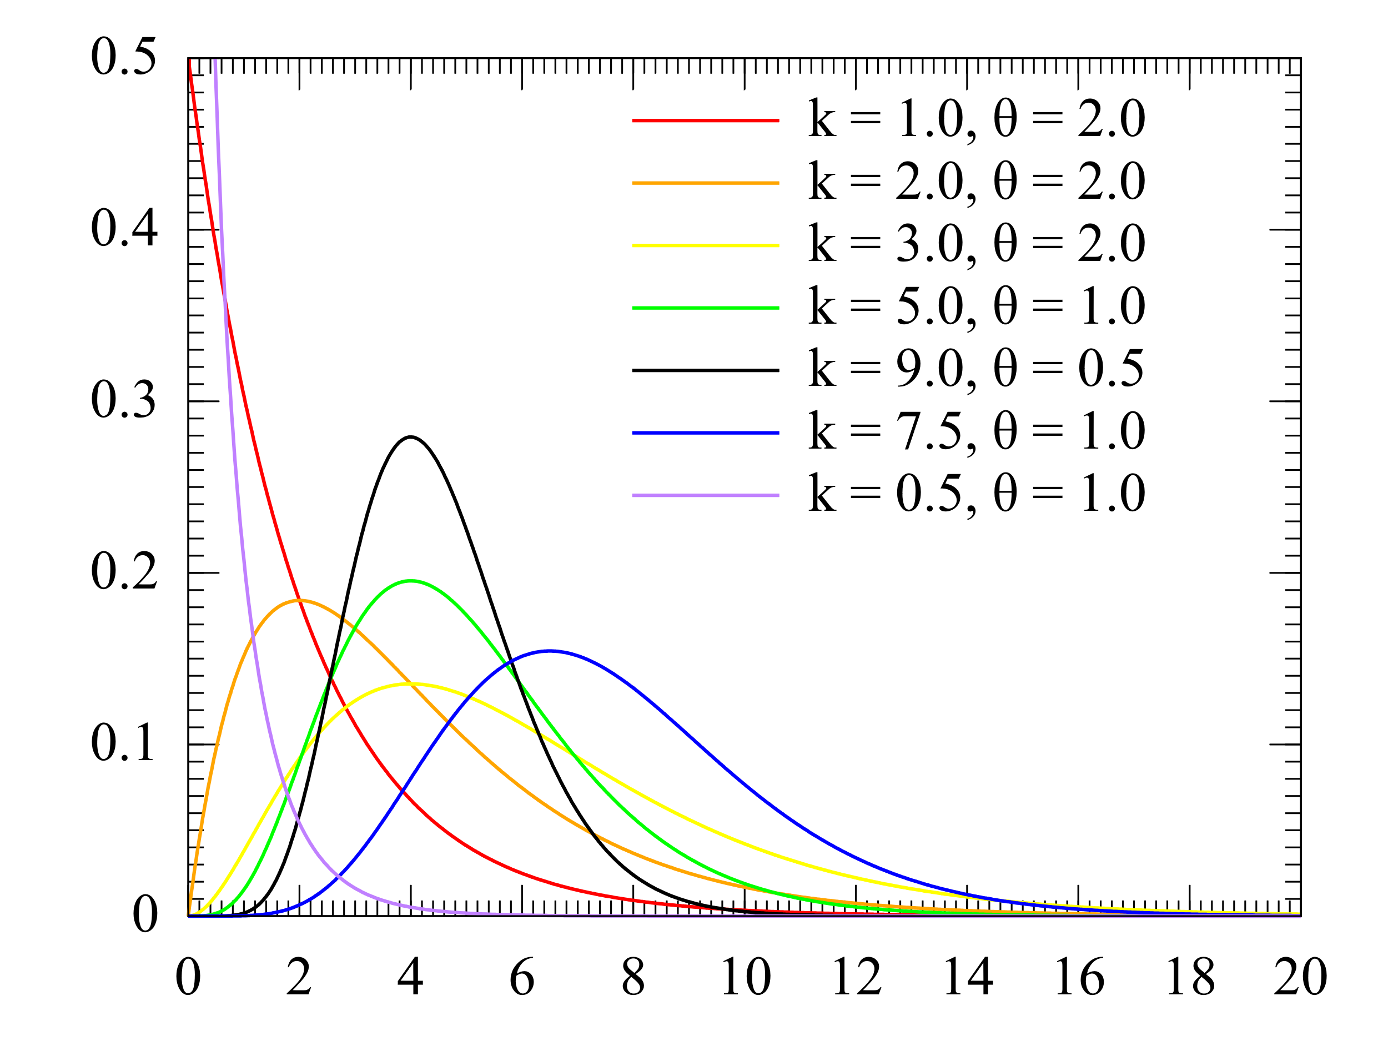
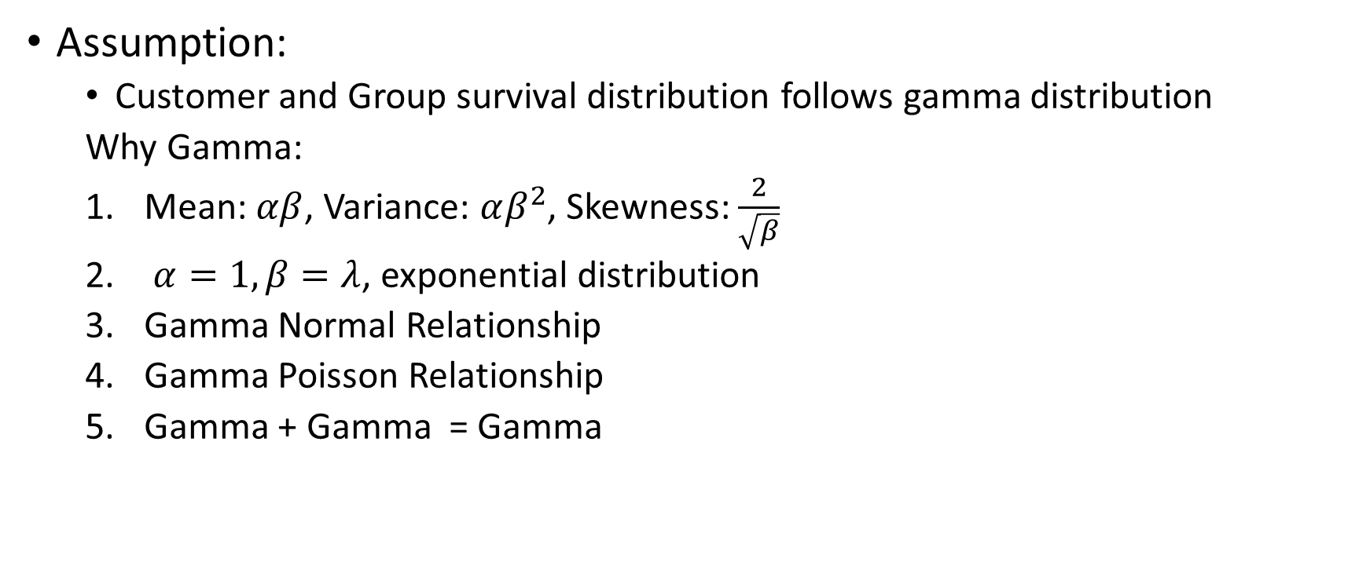
Arrival Forecasting
Gamma dist. Quick Review
Adapt from Wikipedia
Assumption:
Customer and Group survival distribution follows gamma distribution
Why Gamma:
Mean: $αβ$, Variance: $αβ^{2}$, Skewness: $\frac{2}{\sqrt{β}}$
$α=1, β=λ$, exponential distribution
Gamma Normal Relationship
Gamma Poisson Relationship
Gamma + Gamma = Gamma
By Gamma_distribution_pdf.png: MarkSweep and Cburnettderivative work: Autopilot (talk) - Gamma_distribution_pdf.png, CC BY-SA 3.0, https://commons.wikimedia.org/w/index.php?curid=10734916

Slide 17
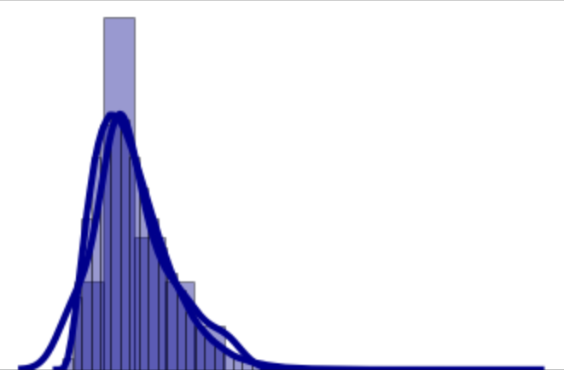
Personal Arrival Forecasting
Forecast when customer will come in small time complexity
probability
Customer A
Previous come
Highest probability will come

Slide 18
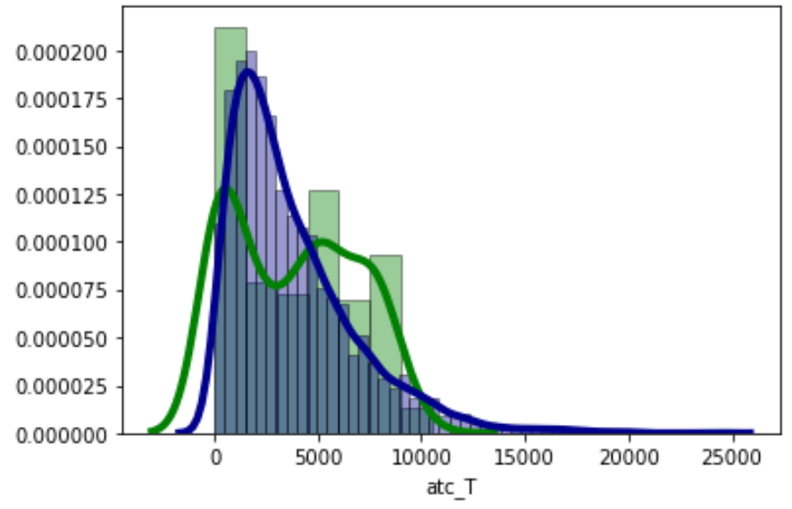
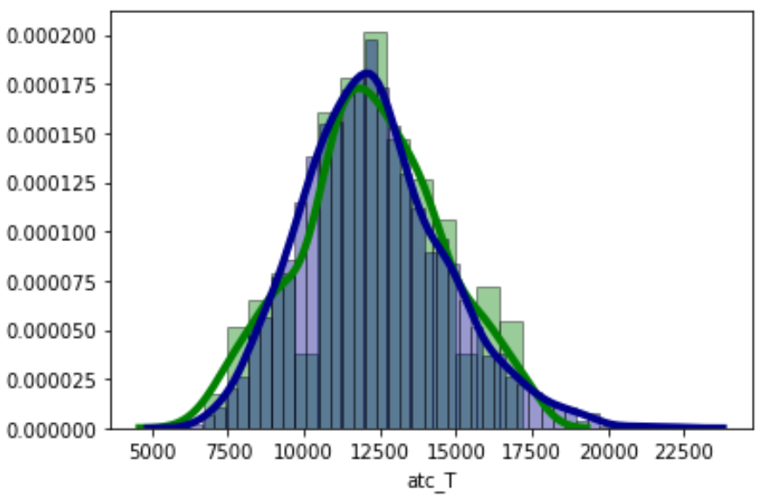
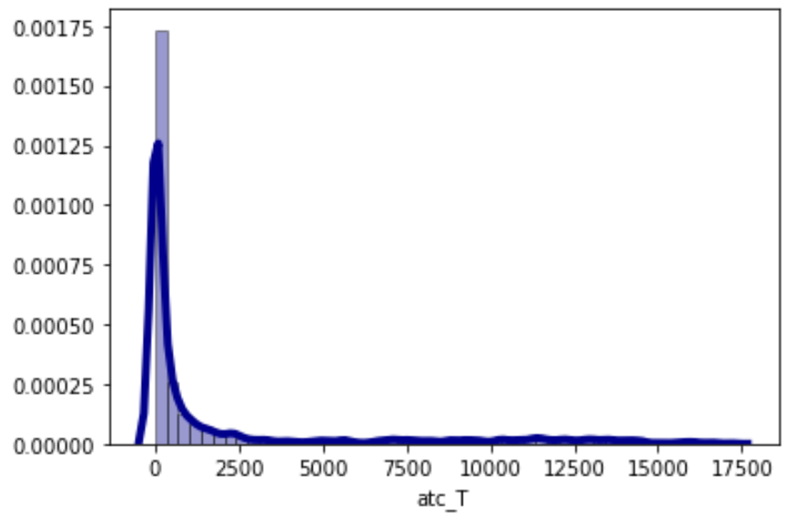
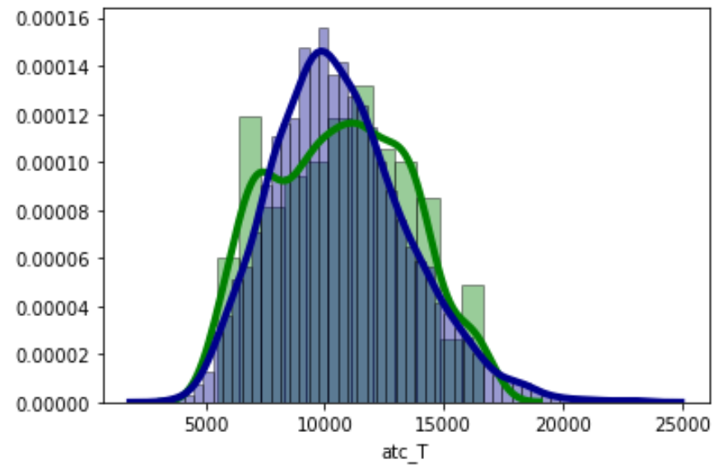
Group Customer Arrival Forecasting

Slide 19
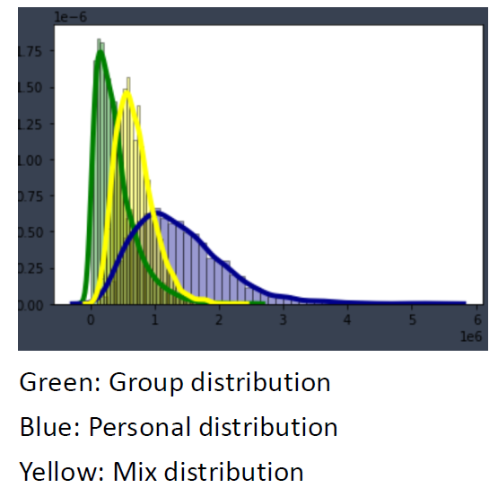
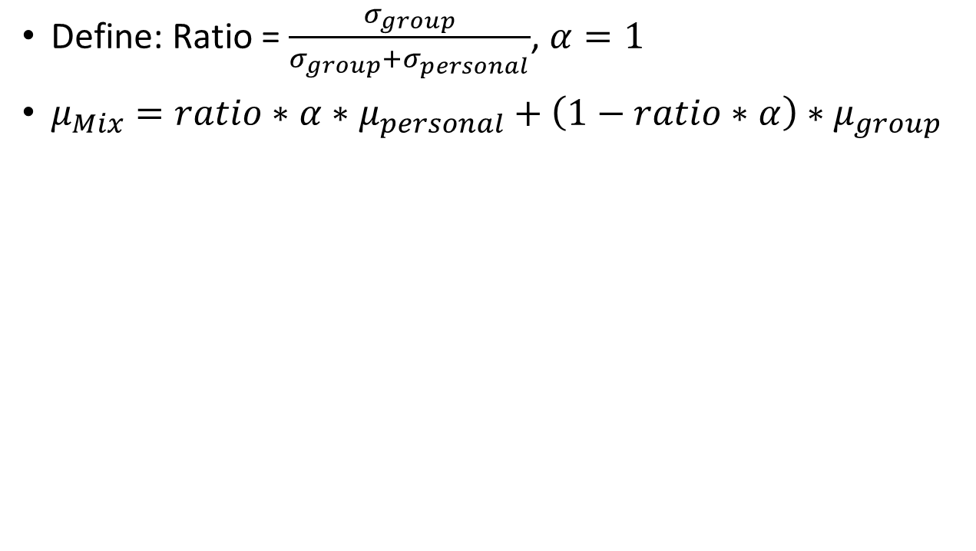
Hedging Variance
Stabilize our model by lowering down our variance
Define: Ratio = $\frac{σ_{group}}{σ_{group}+σ_{personal}}$, $α=1$
$μ_{Mix}=ratio∗α∗μ_{personal}+\left(1−ratio∗α\right)∗μ_{group}$

Slide 20
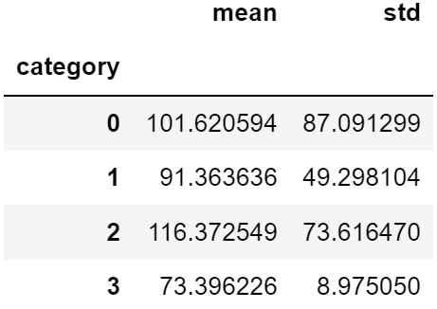
Shipping Fee Marketing
If customer fail to come at our forecasting time, giving them customized shipping fee coupon
Customer A:
Average Shipping Fee: 71.1
Std: 3.33

Slide 21
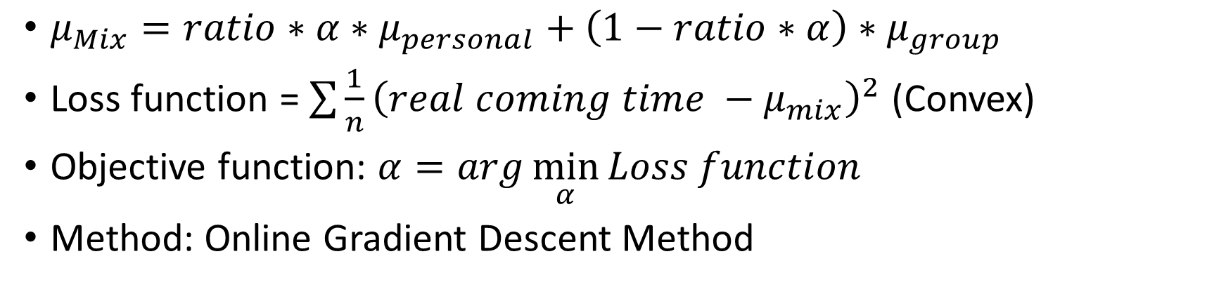
Future Improvement (Optimize 𝛼)
Using online optimization to make model more fit to real world situation
$μ_{Mix}=ratio∗α∗μ_{personal}+\left(1−ratio∗α\right)∗μ_{group}$
Loss function = $\sum{\frac{1}{n}{\left(real coming time −μ_{mix}\right)}^{2}}$ (Convex)
Objective function: $α=arg\min_{α}{Loss function}$
Method: Online Gradient Descent Method

Slide 22
Reference
An e-customer behavior model with online analytical mining for internet marketing planning, Irene S.Y. Kwana,*, Joseph Fongb, H.K. Wongb
A machine learning framework for customer purchase prediction in the non-contractual setting , Andrés Martínez , Claudia Schmuck , Sergiy Pereverzyev Jr. b , Clemens Pirker , Markus Haltmeier
Statistical Inference. Duxbury Press. Casella, G. and Berger, R. L. (2002)
Regression Analysis: Theory, Methods, and Applications. Springer., A. Sen and M. Srivastava (1990)
An LTV model and customer segmentation based on customer value: a case study on the wireless telecommunication industry, Hyunseok Hwang, Taesoo Jung, Euiho Suh
Segmentation approaches in data-mining: A comparison of RFM, CHAID, and logistic regression, Journal of Business Research, JA McCarty, M Hastak
RFM and CLV: Using Iso-Value Curves for Customer Base Analysis, Journal of Marketing Research, PS Fader, BGS Hardie, KL Lee
The gamma CUSUM chart method for online customer churn prediction, Ssu-HanChen
Prediction, learning, and games, N Cesa-Bianchi, G Lugosi – 2006
Prediction, optimization, and learning in repeated games, JH Nachbar - Econometrica: Journal of the Econometric Society, 1997
River: machine learning for streaming data in Python, Jacob Montiel, Max Halford, Saulo Martiello Mastelini, Geoffrey Bolmier, Raphael Sourty, Robin Vaysse, Adil Zouitine, Heitor Murilo Gomes, Jesse Read, Talel Abdessalem, Albert Bifet

Slide 23
Courses that Inspired me on this project !!!
管院
MBA 7028 行銷研究, 柯冠州
MBA 7025 管理科學模式, 余峻瑜
IB 5082 大數據行銷, 任立中
IB 7055 行銷管理, 林俊昇
IM 5056 統計學習與深度學習, 盧信銘
MBA 5078 物聯網下的商業統計分析, 楊曙榮
IM 2011 商管程式設計, 孔令傑
Fin 7035 商業賽局模型, 陳其美
Fin 7006 證券市場微結構理論, 陳其美
BA 2005 作業管理, 郭家偉
工業工程所
IE 5057 時序資料分析, 藍俊宏
IE 5056 最佳化概論, 洪一薰
IE 7020 整數與組合最佳化,黃奎隆
數學系(所)
MATH 1104/1103 線性代數(I)(II), 余正道
MATH 2213/2214 分析導論(I)(II), 王振男
MATH 7606 迴歸分析, 丘政民
MATH 7603/7604 高等統計推論(I)(II), 江金倉
資訊工程系(所)
CSIE 1212 資料結構與演算法, 林軒田, 蔡欣穆
CSIE2136 演算法設計與分析, 陳縕儂
CSIE5431 深度學習之應用,陳縕儂
CSIE5410 最佳化演算法, 李彥寰
CSIE5002 預測、學習、與賽局

Slide 24
Special Thank
台大工管系 陳文華老師
VeryBuy創辦人 楊怡婷 學姊

Slide 25
Contact & Thank you
If you have any problem, feel free to contact me any time.
Email: b07701150@ntu.edu.tw
Tel: 0909692457

